Slide 1

Game Theory:
Lights-Out game

Slide 2
Supervised & Presented
Presented by:
Radwa S. Khattab
Ahmed M. Zakaria
Abdelrahman M. Badr
Prepared by:
Abdullah Ezzat
Radwa S. Khattab
Ahmed M. Zakaria
Abdelrahman M. Badr
Ayman Azzam
Ahmed Essam
Submitted to:
Dr. Samah Elshafiey Eltantawy

Slide 3
Content
What is Game Theory?
Uses & Applications
Representation of games
Type of games
Lights-Out game

Slide 4
Game Theory?
The math and science behind any social interaction and the decisions made at which.
It models this situations using math concepts, solves them, and gets most-optimum decisions at any case for any situation.

Slide 5
Applications
Description and modeling
Prescriptive or normative Analysis
Economics and business
Political science
Biology
Computer science and logic

Slide 6
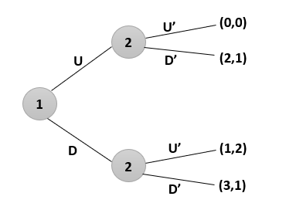
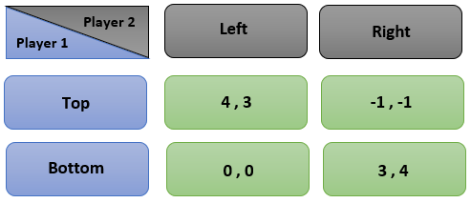
Representation of Games
Extensive Form
Normal Form
It represents games in form of graphs, by showing all possible sequential moves for each player, and their choices at each point of separation.
It represents games without graphical representation, but rather in form on matrices. Some information is lost in this form, unlike in extensive form.

Slide 7
Game type
Cooperative & Non-cooperative
Zero-sum & Non-zero-sum
Perfect Infor. & Imperfect Info.
Combinatorial

Slide 8
Cooperative games
Non-cooperative games
Players communicate together, seeking one common goal.
Game Theory analysis addresses two questions:
What coalitions will form when all individuals cooperate?
What is each of their shares in their common payoff?
Players don’t communicate, and they seek different goals.
There are winners and losers.
There is no coalitions formed.
More general than cooperative games.

Slide 9
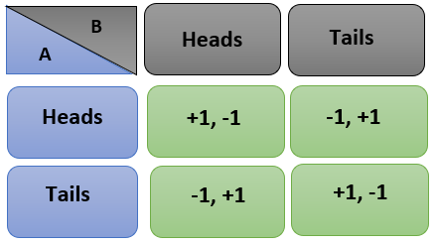
Zero-sum games
Non-zero-sum games
In this kind of games, a player’s gain is equal to another’s loss.
Sum of player’s payoff add up to zero.
Non-zero-sum games have optimal solution.
More close to the real world life.
Sum of player’s payoff don’t add up to zero.
Players may have different interests, or complementary

Slide 10
Perfect information games
Imperfect info. games
All players know the moves previously made by all other players.
Players don’t know exactly what action other player took up to the point of decision.

Slide 11
Combinatorial
Games in which it’s difficult to find an optimal strategy due to the multiplicity of the possible moves.
Examples: Chess, and Go.

Slide 12
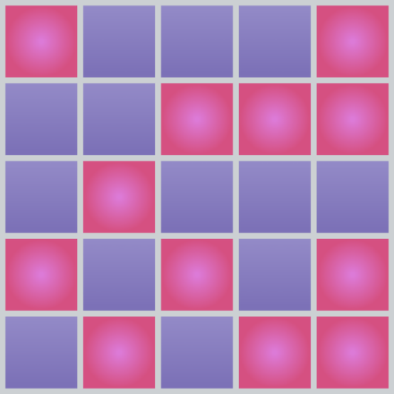
Problem Description
Light Out game
Your mission is closing all lids and if you success try again to reach the minimum number of pushing .

Slide 13
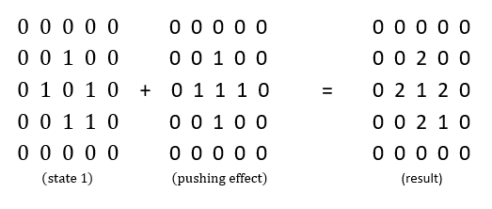
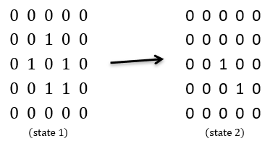
Algorithm of solution

Slide 14
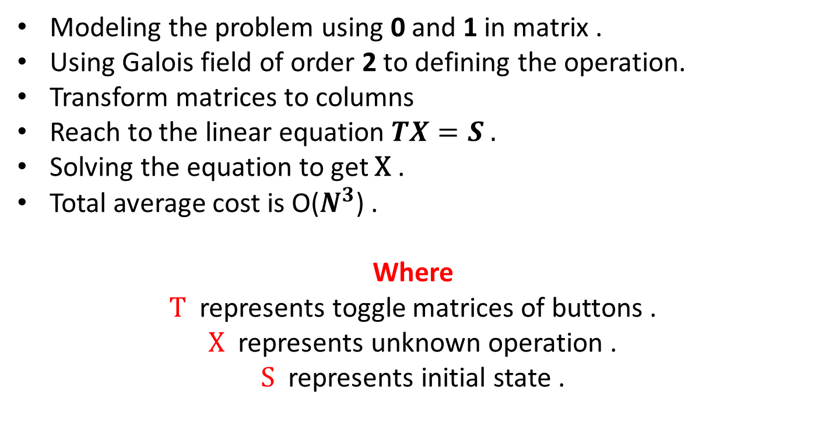
Algorithm of solution
Modeling the problem using 0 and 1 in matrix .
Using Galois field of order 2 to defining the operation.
Transform matrices to columns
Reach to the linear equation $TX=S .$
Solving the equation to get X .
Total average cost is O($N^{3}$) .
Where T represents toggle matrices of buttons .
X represents unknown operation .
S represents initial state .

Slide 15
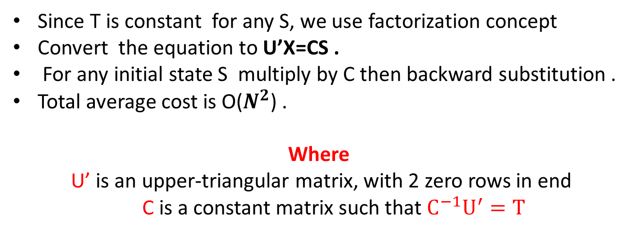
Updated Solutions
Since T is constant for any S, we use factorization concept
Convert the equation to U’X=CS .
For any initial state S multiply by C then backward substitution .
Total average cost is O($N^{2}$) .
Where
U’ is an upper-triangular matrix, with 2 zero rows in end
C is a constant matrix such that $C^{−1}U^{′}=T$

Slide 16

Any questions
Thank you

